Slide 1

Four Seasons Tours and Travels
ABOUT US
TOUR PACKAGES
CONTACT US
About us
Customer Login
Register here

Slide 2
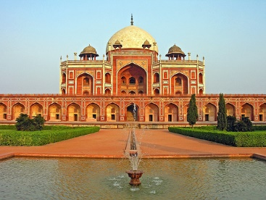
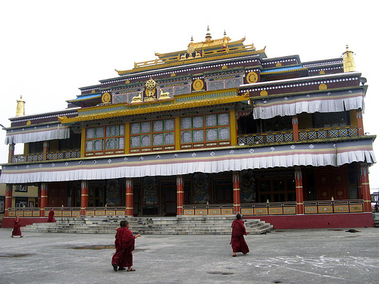
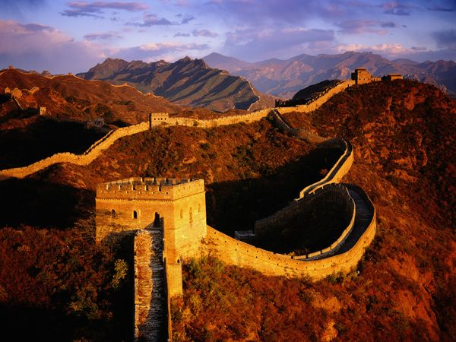
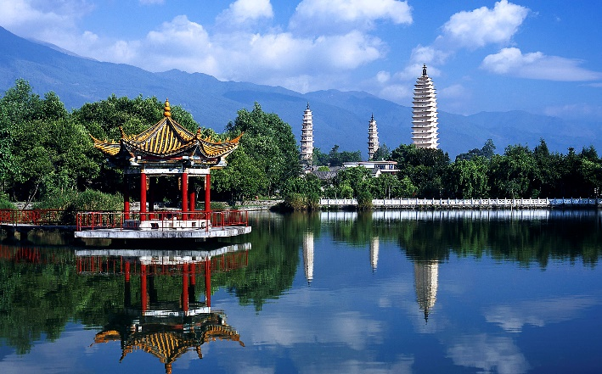
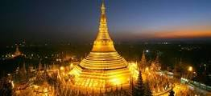
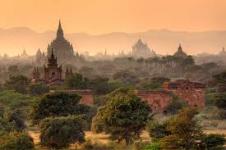
TOUR PACKAGES
Compare
View Details
View Details
View Details
5D Beauty of Sikkim
5D Kashmir in spring
Add to compare
5D Soul of China
Add to compare
Add to compare
View Details
7D Impression of Myanmar
View Details
View Details
5D Golden Rock
10D Foothills of China
Add to compare
Add to compare
Add to compare

Slide 3
5 Days Kashmir in Spring
There will be 4 tours in a year :
Tour dates: Mar 1st - Mar 5th
May 1^{st -}May 5th
Aug 1st - Aug 5th
Nov 1st - Nov 5th
Total cost : S$5500
Click here for detailed cost , hotel and flight details
For more information please call: +65 12345678
Tour Code: MSVFA1
Day 1: Singapore-Kashmir (Meal on board)
Assemble at Changi International Airport for your flight to India(Kashmir)
Day 2: Kashmir(Breakfast/Lunch/Dinner)
Arrive to Srinagar and you will be escorted to your hotel/houseboat. In the evening Shikara ride on Dal Lake to enjoy the sunset. Overnight stay at Srinagar.
Day 3: Srinagar (Garden and Lakes)
Half day trip to the celebrated Mogul gardens-Nishat Bagh and Shalimar Bagh. Nishat Bagh. Visit floating vegetables and gardens. Overnight stay at Srinagar.

Slide 4
5 Days Kashmir in Spring
Day 4: Srinagar to Gulmarg
In the morning start for Gulmarg-the Meadow of Flowers, which is situated at an altitude of 2730 m above the sea level. Pony riding to the upland meadow of Khilanmarg The Gondola Cable Car offers rides to the upland meadow of Kongdori for viewing the Himalayan peaks in the summer and for downhill skiing in winter. Overnight stay in Gulmarg
Day 5: Gulmarg to Srinagar and Srinagar to Singapore
In the morning start from Gulmarg to Srinagar. Rest in Taj hotel for 2 hours. In the afternoon , board Jet airways ,Srinagar to Singapore.

Slide 5
Tour Fare for 5 Days Kashmir in Spring
Tour Charges : S$3000
Flight Charges : S$1000(Jet Airways -From Singapore to Srinagar and Srinagar to Singapore) Go to flight details
Hotel Charges : S$1500(Stay in Taj Hotel.Srinagar) Go to hotel details
Visa Application :S$10
Total charges : S$5510
Availability: 52
Click here to book the tour

Slide 6
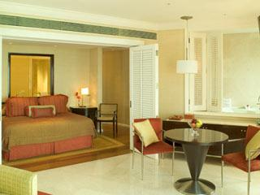
Hotel details
Taj Hotel Srinagar
Luxury room(1 Hall,1 bedroom,1 balcony)
Beautiful sceneries view from the balcony
Rate – S$ 320/day
Availability – 100 rooms
Dates Available -March 1st 2014, May 1st 2014,Aug 1st 2014,Nov 1st 2014
Chola Hotel Srinagar
Luxury room(1 Hall,1 bedroom,1 balcony)
Nice chola puries at our restaurant
Rate – S$ 300/day
Availability – 100 rooms
Dates Available -March 1st 2014, May 1st 2014,Aug 1st 2014,Nov 1st 2014

Slide 7
Flight Details
Jet airways
From Singapore to Srinagar
Dates Available : March 1st 2014, May 1st 2014,Aug 1st 2014,Nov 1st 2014
Fare: S$500
Availability : 10
From Srinagar to Singapore
Dates Available : March 4st 2014, May 4st 2014,Aug 4st 2014,Nov 1st 2014
Fare: S$500
Availability : 10

Slide 8
5 Days Beauty of Sikkim
There will be 4 tours in a year :
Tour dates: Apr 1st - Apr 4th
Jun 1^{st -}Jun 4th
Sep 1st - Sep 4th
Dec 1st - Dec 4th
Total cost : S$5510
Click here for detailed cost , hotel and flight details
For more information please call: +65 12345678
Tour Code: MSVFA5
Day 1: Singapore-Sikkim (Meal on board)
Assemble at Changi International Airport for your flight to India(Sikkim)
Day 2: Sikkim(Breakfast/Lunch/Dinner)
Arrive to Gangtok and you will be escorted to your 5 star hotel. In the evening visit to Tiger hill to enjoy the sunset. Overnight stay at Gangtok.
Day 3: Gangtok(Garden and Lakes)
Half day trip to the celebrated the snow hill and a frozen lake in the height of 12500 feet above the sea level. Overnight stay at Gangtok.

Slide 9
5 Days Beauty of Sikkim
Day 4: Gangtok(City Tour)
Half day trip to the heart of the city for shopping Sikkim’s marvellous art of work in Silver and brass. Overnight stay at Gangtok.
Day 5: Gangtok(Food Tour)
Full day trip to the village of Sikkim in the mountains to try various kinds of vegetarian foods like momu,pasta etc

Slide 10
Tour Fare for 5 Days Beauty of Sikkim
Tour Charges : S$3000
Flight Charges : S$1000(Jet Airways -From Singapore to Gangtok and Srinagar to Gangtok) Go to flight details
Hotel Charges : S$1500(Stay in Taj Hotel.Gangtok) Go to hotel details
Visa Application :S$10
Total charges : S$5510
Availability: 52
Click here to book the tour

Slide 11
Hotel details
Taj Hotel Gangtok
Luxury room(1 Hall,1 bedroom,1 balcony)
Beautiful sceneries view from the balcony
Rate – S$ 320/day
Availability – 100 rooms
Dates Available -Apr1st 2014, Jun1st 2014,Sep1st 2014,Dec 1st 2014
Chola Hotel Gangtok
Luxury room(1 Hall,1 bedroom,1 balcony)
Nice chola puries at our restaurant
Rate – S$ 300/day
Availability – 100 rooms
Dates Available - Apr1st 2014, Jun1st 2014,Sep1st 2014,Dec 1st 2014

Slide 12
Flight Details
Jet airways
From Singapore to Gangtok
Dates Available : Apr1st 2014, Jun1st 2014,Sep1st 2014,Dec 1st 2014
Fare: S$500
Availability : 10
From Gangtok to Singapore
Dates Available : Apr1st 2014, Jun1st 2014,Sep1st 2014,Dec 1st 2014
Fare: S$500
Availability : 10

Slide 13
5 Days Golden Rock Grandeur
There will be 4 tours in a year :
Tour dates: Mar 5st - Mar 10th
May 15^{st -}May 20th
Aug 10st - Aug 15th
Dec 25st – Dec 30th
Click here for detailed cost , hotel and flight details
For more information please call: +65 12345678
Tour Code: 5DMMGR
Day 1: Singapore – Yangon ( Meal on board )
Upon arrival, a warm welcome by our local guide at the arrival hall where she will assist and arrange your transfers to your selected hotel for check in. After check-in, you will be invited to a local restaurant for a sumptuous dinner.
Day 2: Yangon – Kyaikhtiyo ( Breakfast/ Lunch/ Dinner )
Embark on an eye opening and enjoyable excursion by road and absorb in the rustic beauty of Myanmar, 190 km east of Yangon to Kyaikhtiyo. After lunch, be prepared to catch the grandiose of the moment of the magnificent and famous Golden Rock, a huge boulder completely covered by gold leaf and delicately balanced on the edge of a cliff. An incredible feat of nature! The evening ends with an overnight stay at Hotel.
Day 3: Kyaikhtiyo – Bago – Yangon ( Breakfast / Lunch / Dinner )
After a simple hot breakfast, continue by road 110km to Bago. On the way, excursion highlights to Bago include; a revered Chinese Guan Yin Temple and Bago Market. After lunch, return to Yangon, en route, visit and experience history at the World War II Allied War Grave cemetery near HTAUKKYANT. Scrumptious dinner at local restaurant awaits you and a clean and luxurious room awaits your tired body for a well-deserved rest at your hotel.

Slide 14
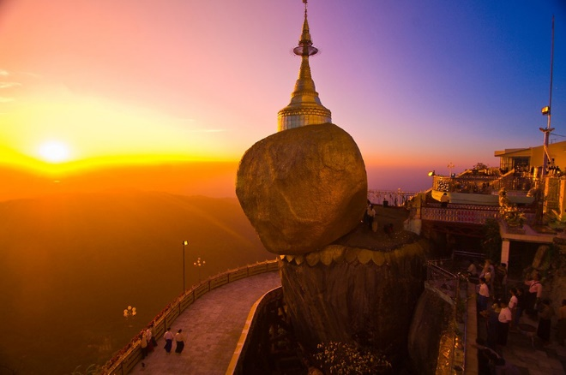
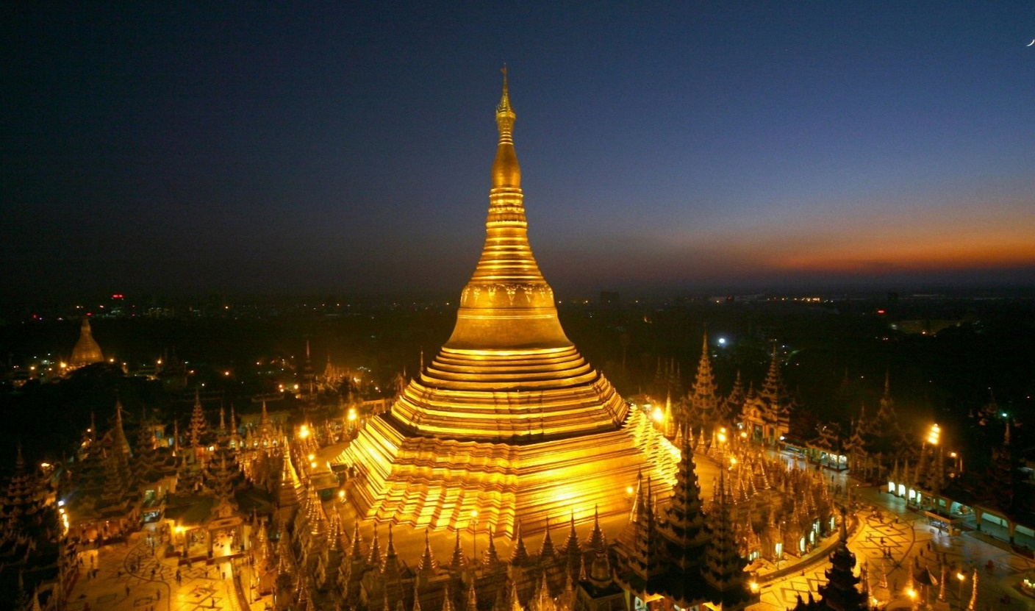
Tour Code: 5DMMGR
Day 4: Yangon ( Breakfast/ Lunch/ Dinner )
Yangon City Tour which takes you to the Strand Jetty, Sule Pagoda - the heart of the city surrounded by several old but significant colonial style buildings which allow you experience how the Europeans influenced Myanmar history and culture. The tour continues with a visit to Bogyoke Market (also known as Scott Market) to browse and bargain freely among the hundreds of stalls for great souvenirs. End your day with an enchanting evening visit to Myanmar’s most revered Shwedagon Pagoda - 2500 years’ old world famous Golden Stupa where the dome shape rises 98 meters above its base.
Day 5: Yangon – Singapore ( Breakfast )
After breakfast at your hotel, transfer to airport for your departure flight.

Slide 15
Tour Fare for 5 Days Golden Rock Grandeur
Tour Charges : S$1400
Flight Charges : S$500 ( SILKAIR Singapore ⬄ Yangon ) Go to flight details
Hotel Charges : 4 Nights accommodation on twin shared
basic with daily breakfast Go to hotel details
Visa Application : S$10
Total charges : S$1910
Click here for booking the tour

Slide 16
Hotel details
East Hotel ( Yangon )
Luxury room(1 Hall,1 bedroom,1 balcony)
Near Sule Pagoda and Bogyoke Market
Rate – S$ 100/day
Availability – 50 rooms
Mountain Top Hotel ( Kyaikhtiyo )
Luxury room(1 Hall,1 bedroom,1 balcony)
Mountain view at our restaurant
Rate – S$ 150/day
Availability – 50 rooms

Slide 17
Flight Details
SILKAIR airways
From Singapore to Yangon
Date: March 5th 2014, May 1th 2014, August 10th 2014, December 25th 2014
Fare: S$ 250
Availability : 10
From Yangon to Singapore
Date: March 10th 2014, May 20th 2014, August 15th 2014, December 30th 2014
Fare: S$ 250
Availability : 10

Slide 18
7 Days Impression of Myanmar
There will be 7 tours in a year :
Tour dates: Mar 10st - Mar 16th
July 16^{st -} July 22th
Oct 1st - Oct 7th
Dec 15st - Dec 21th
Click here for detailed cost , hotel and flight details
For more information please call: +65 12345678
Tour Code: 7DMMIM
Day 1: Singapore - Yangon arrival and sightseeing ( Meals included: None )
After refreshment at hotel, enjoy a walk through downtown Yangon where most of the colonial buildings such as city hall, Mahabandoola park, high court and telegraphic office are holding an elegant beauty of Yangon. Stopover at the Strand Hotel and feel the warmth and atmosphere of British era. Continue visit to Pansoedan jetty serving locals living across the Yangon River. This evening visit to the magnificent Shwedagon Pagoda of Rudyard Kipling fame and one of Myanmar's most sacred places. The massive bell shaped stupa is plated with gold and the tip of the stupa is set with diamonds and rubies, sapphires and topaz - a stunning sight as the sun sets and a most fitting place to begin our trip in this "Golden Land". After visiting Shwedagon pagoda, transfer to you hotel and overnight at the hotel in Yangon.
Day 2: Yangon-Bagan( Meals included:Breakfast )
This morning we head for the airport to get the early morning flight to Bagan. Check into the hotel and depart for a sightseeing excursion around the Bagan Archaeological Zone World Heritage Area. A comprehensive exploration of Bagan includes NyaungOo market; Shwezigon Pagoda, the prototype of later Myanmar stupas; KyansitthaUmin; Wet-kyi-inn Gubyaukgyi Temple with exquisite mural painting of 13th century and Htilominlo Temple. In the afternoon, after a visit to lacquer ware workshops; continue to Manuha Temple built by exile King Manuha; Nanphaya, said to have been the residence of King Manuha; Ananda Temple, architectural masterpiece and Oak-Kyaung monastery decorated with multi colour mural paintings. Enjoy the breathtaking sunset from one of the temple of Bagan. Overnight at the hotel in Bagan.

Slide 19
Tour Code: 7DMMIM
Day 3: Bagan – Mt. Popa – Bagan ( Meals included: Breakfast )
We will be watching sunrise over Bagan and back to hotel for breakfast. After breakfast at hotel, we head to Mt. Popa about 48 km south east of Bagan. Mt. Popa, known as the abode of Nats (spirits) - a collection of 37 magical spirits both feared and honoured by some Myanmar people and the nat museum, which houses 37 life-size nat statues sculpted from teak. It's time to climb for 777 steps to the summit. Proceed to Popa Mountain Resort ( 1hr drive ) for lunch (own account). The restaurant offer a great view to the Popa summit that stands straight from the central plain. After lunch, return drive back to Bagan. On the way back, enroute stop at village cottage industry to learn the regional product as well as to watch the collection of juice from the palm trees, and its conversion to brown sugar. Overnight at the hotel in Bagan.
Day 4: Bagan – Heho – Inle Lake ( Meals included: Breakfast )
After breakfast, depart the hotel for flight to Heho on the Shan plateau. Upon arrival, transfer by road to Inle lake. We have a leisurely morning to make our way down into the Inle basin and by “long-tail” boat out across the lake to our Hotel right on the Inle Lake. In the afternoon, we plan to spend the day visiting villages and sampling the spectacular array of traditional handicrafts. You will see the unique method locals use to row their boats, fishermen with their own style of fishing, floating farms and gardens and a handloom weaving cottage with its own showroom. You will visit Phaungdawoo Pagoda which houses the five most revered Buddha Images in the southern Shan State. Overnight at the hotel on Inle Lake.
Day 5: Inle Lake boat excurision ( Meals included : Breakfast )
After breakfast at the hotel, visit floating market which is a 5day rotation market most fascinating to watch the daily life of the minorities and their activities. Continue our excursion by motorized boat to Indein pagoda complex, in the south-west of the lake. The boat leaves the lake and enters a narrow canal with a beautiful natural environment to continue to a small Pa O tribe village. From the village, follow an old covered path to a 13th century monastery and the very impressive ruins of hundreds of ancient pagodas, some hidden in the vegetation. The main stupa-area on the top of the hill offers breathtaking views over the surrounding mountains and down to the valley and the lake in the far distance. Return to your hotel and overnight at the hotel in Inle Lake.
Day 6: Inle Lake – Heho – Yangon ( Meals include : Breakfast )
After breakfast, we are heading back down country today to return to the airport at Heho for our flight to Yangon. Check in at airport and fly back to Yangon. Upon arrival, transfer to your hotel in Yangon. This afternoon, visit by car to Karaweik, a royal barge for fantastic photo shot along the "pilgrims" causeway across the Royal Lake with stunning views of Shwedagon Pagoda and proceed to visit Chaukhtutgyi Reclining Buddha Image and there you see the sparse pilgrims in silence. Also we will stop by at Bogyoke Aung San (Scott) market famous for its colonial architecture and inner cobblestone streets. It is one of the major bazaars in Yangon and built in 1926 by the British. You can buy from a simple Myanmar slipper to a jewellery crown there. Overnight at the hotel in Yangon.

Slide 20
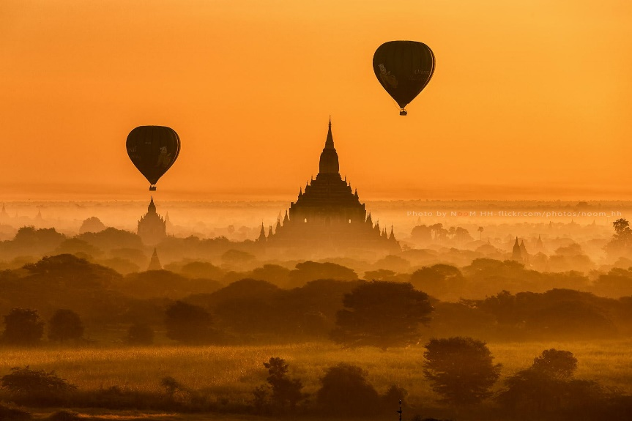
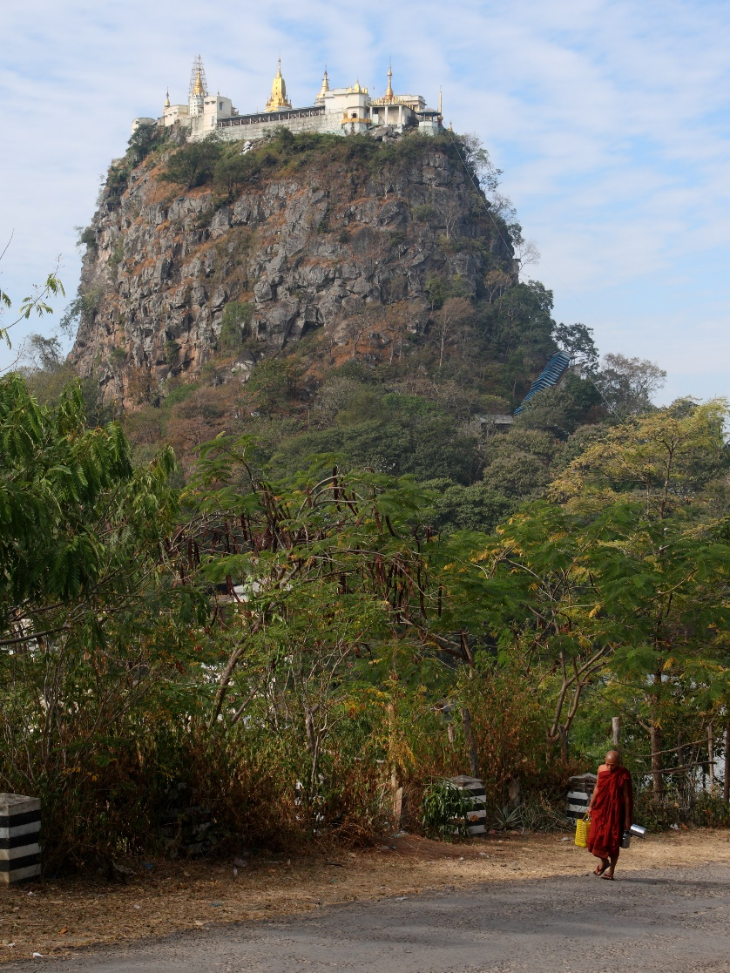
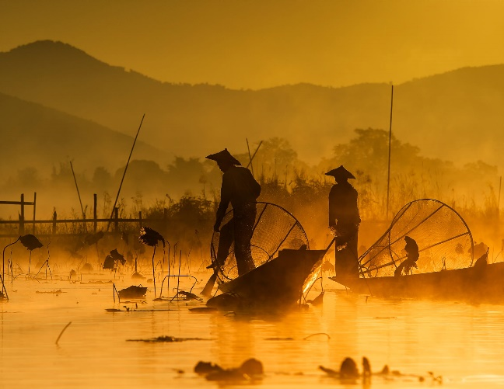
Tour Code: 7DMMIM
Day 7: Yangon Departure ( Meals : included breakfast )
After breakfast at hotel, you will be picked up by your guide and transferred to Yangon International airport for your return international departure flight. (OR free morning until your departure time.)

Slide 21
Tour Fare for 7 Days Impression of Myanmar
Tour Charges : S$2600
Flight Charges : S$500 ( SILKAIR Singapore ⬄ Yangon ) Go to flight details
Hotel Charges : 6 Nights accommodation on twin
shared basic with daily breakfast Go to hotel details
Visa Application : S$10
Total charges : S$3110
Click here for booking the tour

Slide 22
Hotel details
East Hotel ( Yangon )
Luxury room( 1 Hall, 1 bedroom, 1 balcony )
Near Sule Pagoda and Bogyoke Market
Rate – S$ 100/day
Availability – 50 rooms
Thazin Garden Hotel ( Bagan )
Luxury room ( 1 Hall, 1 bedroom, 1 balcony )
Mountain view at our restaurant
Rate – S$ 160/day
Availability – 50 rooms
Amata Garden Resort ( Inle Lake )
Luxury room(1 Hall, 1 bedroom, 1 balcony)
Mountain view at our restaurant
Rate – S$ 300/day
Availability – 50 rooms

Slide 23
Flight Details
SILKAIR airways
From Singapore to Yangon
Date: March 10th 2014, July 16th 2014, October 1st 2014, Dec 15th 2014
Fare: S$ 190
Availability : 50
From Yangon to Singapore
Date: March 16th 2014, July 22th 2014, October 7th 2014, Dec 21th 2014
Fare: S$ 190
Availability :50

Slide 24
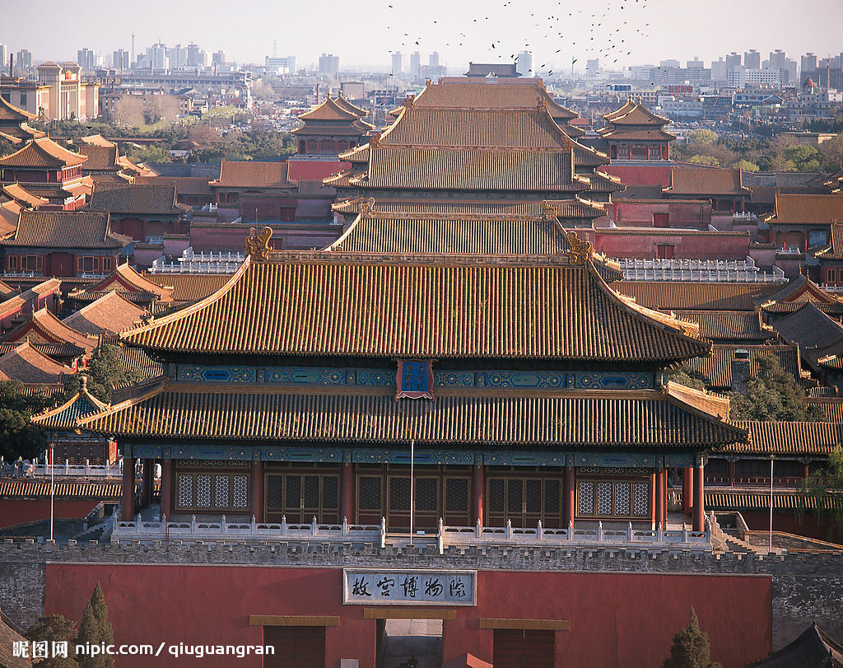
5 Days for Soul of China--- Beijing Tour Package
There will be 4 tours in a year:
Jan.1st—Jan.5th total cost: S$2000
Apr.1st—Apr.5th total cost: S$2000
July.1st—July.5th total cost: S$2000
Sep.1st—Sep.5th total cost: S$2000
If you want to get more information, you can
contact :+65 52001314 or send an email to
fourseasons@gmail.com

Slide 25
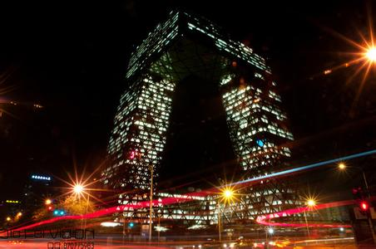
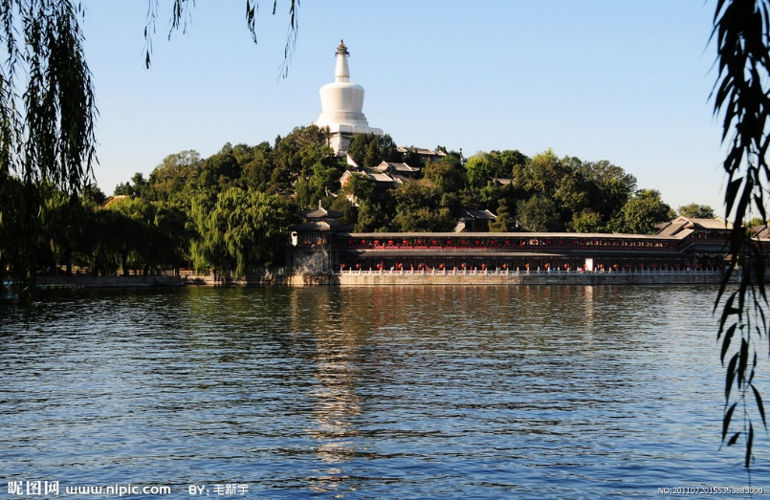
Tour code: 5DCHB
Duration: 5 days (start from about 8:00 am and back around 5:00pm)
Attraction: Day 1 – Beijing Airport to hotel Private Transfer Service; Day 2 – Badaling Great Wall, Ming Tombs; Day 3 – Tiananmen Square, Forbidden City, Temple of Heaven, Summer Palace; Day 4 – Hutong, Lama Temple, Panda House, Olympic Stadium; Day 5 – Hotel to Beijing Airport Private Transfer Service.
Detailed Fares:
Tour Charges : S$1000
Flight Charges : S$1000( SQAIRLINE Singapore ⬄ Beijing ) Go to flight details
Hotel Charges : S$800(4 Nights accommodation on twin shared basic with daily breakfast)
Go to hotel details
Visa Application : S$50
Total charges : S$2850

Slide 26
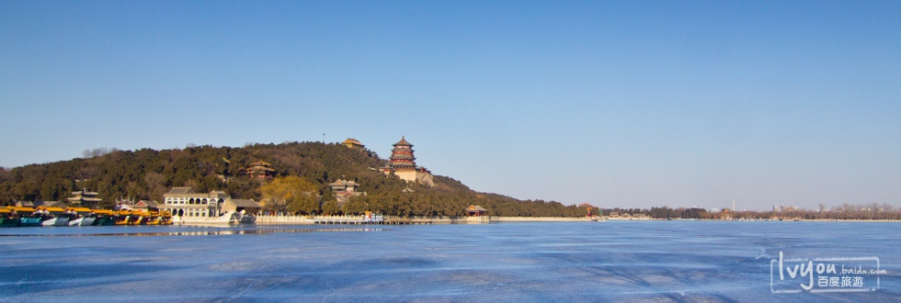
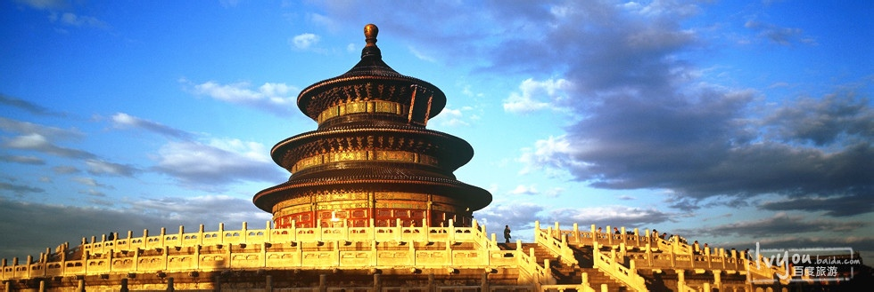
Day 1
Private transfer service for you from Beijing airport to your hotel by our driver (without tour guide), and our driver will hold a sign with your name at the exit.

Slide 27
Day2
1. Pick you up from your hotel on departure time, and then drive to the Ming Tomb. You will visit Changling. The sightseeing on the Ming Tombs takes about 1 hour. The visit to Ming Tombs finishes at about 10:45. Before having lunch (11:30 am), you will have 45 minutes for a short visit of Jade Carving Factory. The jade carving is a famous special Chinese product, a blend of the excellent skill on carving and Chinese traditional cultures. - Ming Tomb: Buried 13 emperors of Ming Dynasty, it is the largest clusters of imperial cemeteries in China. - Changling: The tomb of Emperor Chengzu and his empress, is the largest and most magnificent one of Ming Tombs.
2. Having traditional Chinese lunch at Jindian restaurant. After lunch, drive to the Badaling Great Wall. The hike on Badaling Great Wall takes 2 hours. Cable car is available and optional. - Badaling Great Wall: The most famous and best-preserved section of the Great Wall.
3. On the way to your hotels, we will drive by "the Bird's Nest,water cube"---the main Olympic Stadium built for the 2008 Olympic Games. After that, you will have a chance to enjoy the Chinese traditional Silk arts. After the tour, transfer back to your hotels.
Day 3
1. Picking up travelers from hotel on departure time, and then driving to theTiananmen Square, then visit Forbidden City (including the Exhibition of Treasures). - Tiananmen Square: The largest public square in the world with a total area of 440,000 square meters. - Forbidden City: The best preserved imperial palace in China and the largest ancient palatial structure in the world.
2. Drive (20 minutes) to the Temple of Heaven. On the way to the Temple of Heaven, you will have a chance to visit the Chinese traditional medicine culture. - Temple of Heaven: The largest existing complex of ancient sacrificial buildings in China.
3. After Chinese lunch (40 minutes) in Restaurant. Enjoy a short visit to a pearl free market.
4, Driving (30 minutes) to Summer Palace, the largest and most beautiful Chinese imperial garden. Visit it for about 1.5 hours. - Summer Palace: The largest and most well-preserved royal park in China, greatly influences Chinese horticulture.
5. At last, driving the travelers back to guest hotel.

Slide 28
Day 4
1. Pick up at your hotel between 7:20am and 8:30am, and then driving to Beijing Zoo to see the lovely Giant Pandas. - Beijing Zoo:China's and World's largest treasure house of animals and birds, also there are pandas.
2. Then take you to the Lama Temple, 1 hour tour for the mysterious Tibet style Buddhism temple. Before having lunch (12:00), you will have 45 minutes to visit the Chinese traditional porcelain shop. After lunch, continue to visit the ancient hutong by rickshaws. - Lama Temple: The largest and most perfectly preserved lamasery of Gelug Sect in present day Beijing.
3. Then head to the Olympic Stadium where you have about 45 minutes to take pictures at the Bird's Nest and water cube. On the way to your hotels, we also arrange the short visit to a China Tea House to enjoy tea ceremony.
4. Transfer back to your hotels.

Slide 29
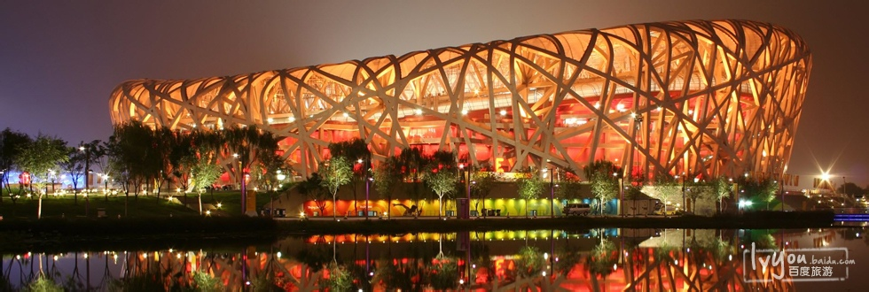
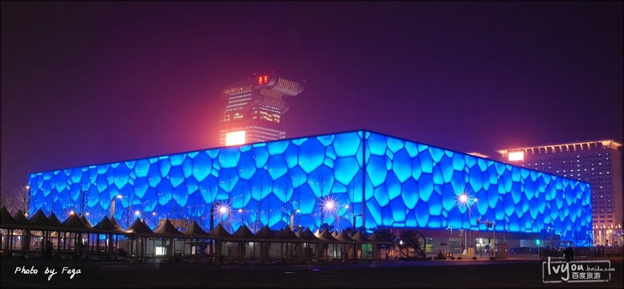
Day 5
Free on your own, and transfer you to the hotel for departure! Tour End!

Slide 30
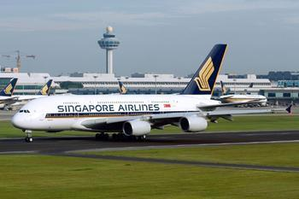
Flight Details
Singapore Airline
Singapore Changi Airport to Beijing Capital International Airport
Fare: S$500
Availability:15
Beijing Capital International Airport to Singapore Changi Airport
Fare: S$500
Availability:15

Slide 31
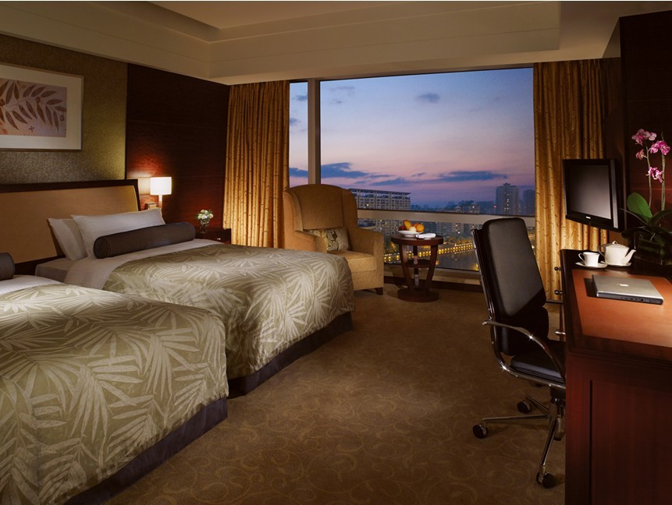
Hotel Details
China World Trade Center Tower 3
Luxury room(1 Hall,1 bedroom,1 balcony)
Beautiful sceneries view from the balcony
Rate – S$ 800/day
Availability – 100 rooms
Beijing Hotel
Luxury room(1 Hall,1 bedroom,1 balcony)
Beautiful sceneries view from the balcony
Rate – S$ 800/day
Availability – 100 rooms

Slide 32
Compare All Tours
Tour Code | MSVFA1 | MSVFA5 | 5DMMGR | 7DMMIM | MSVFA3
Tour name | Kashmir in spring | Beauty of Sikkim | Golden Rock Grandeur | Impressioin of Myanmar | Soul of China
Tour duration | 5 | 5 | 5 | 7 | 5
Tour availability | 1st of Mar,May,Aug,Nov | 1st of Apr,Jun,Sep,Dec | 5th of Mar,15th of May,10th of Aug, 25th of Dec | 10th of Mar,16th of July,1st of Oct, 15th of Dec | 1st of Jan,Apr,Jul,Sep
Hotels | Taj,Chola | Taj,Chola | East Hotel, Mountain Top Hotel | East Hotel, Thazin Garden Hotel, Amata Garden Resort
Flights | Jet airways | Jet airways | SILKAIR airways | SILKAIR airways | SILKAIR airways
Hotel Availability | 100 | 100 | 50 | 50 | 100
Flight Availability | 10 | 10 | 50 | 50 | 15
Tour charges | S$3000 | S$3000 | S$5000 | S$5000
Hotel room rate | S$1500 | S$1500 | S$1000 | S$1000 | S$600
Flight rate | S$1000 | S$1000 | S$1000 | S$1000 | S$1000
Visa rate | S$10 | S$10 | S$10 | S$10
Total Rate | S$5510 | S$5510 | S$7010 | S$7010

Slide 33
Compare Tours of India
Tour Code | MSVFA1 | MSVFA5
Tour name | Kashmir in spring | Beauty of Sikkim
Tour duration | 5 | 5
Tour availability | 1st of Mar,May,Aug,Nov | 1st of Apr,Jun,Sep,Dec
Hotels | Taj,Chola | Taj,Chola
Flights | Jet airways | Jet airways
Hotel Availability | 100 | 100
Flight Availability | 10 | 10
Tour charges | S$3000 | S$3000
Hotel room rate | S$1500 | S$1500
Flight rate | S$1000 | S$1000
Visa rate | S$10 | S$10
Total Rate | S$5510 | S$5510

Slide 34
Compare Tours of Myanmar
Tour Code | 5DMMGR | 7DMMIM
Tour name | Golden Rock Grandeur | Impressioin of Myanmar
Tour duration | 5 | 7
Tour availability | 5th of Mar,15th of May,10th of Aug, 25th of Dec | 10th of Mar,16th of July,1st of Oct, 15th of Dec
Hotels | East Hotel, Mountain Top Hotel | East Hotel, Thazin Garden Hotel, Amata Garden Resort
Flights | SILKAIR airways | SILKAIR airways
Hotel Availability | 50 | 50
Flight Availability | 50 | 50
Tour charges | S$5000 | S$5000
Hotel room rate | S$1000 | S$1000
Flight rate | S$1000 | S$1000
Visa rate | S$10 | S$10
Total Rate | S$7010 | S$7010

